Slide 1



Introduction to E-Commerce Sales Analysis
Dive into a comprehensive dataset of e-commerce sales, uncover insights to optimize product listings, pricing, and marketing.
By:
Jeel Patel - RA2311056010078
Sarthak Sharma - RA2311056010097

Slide 2
Overview of the Dataset
Product Details
Sales Performance
Trends Over Time
Product ID, name, category
Revenue, orders, customer reviews
Monthly sales, pricing changes

Slide 3

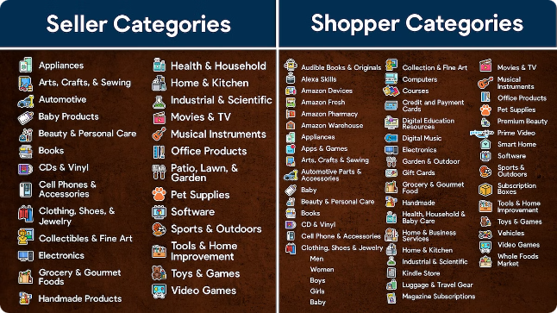
Product Category Analysis
1
Top Selling Categories
2
Emerging Trends
Spot new category growth
Identify high-revenue categories
3
Competitive Landscape
Understand market share by category

Slide 4

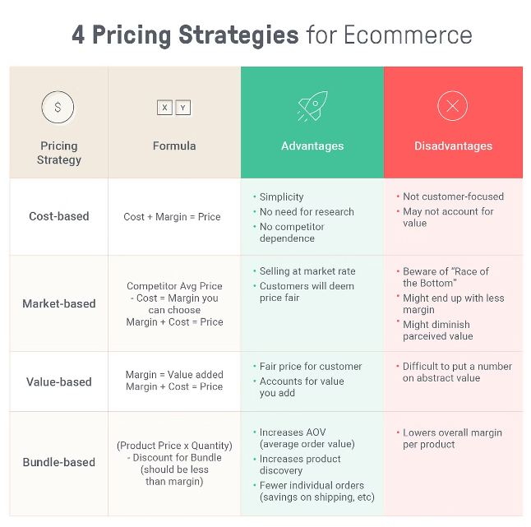
Pricing Strategies and Trends
1
Price Optimization
Analyze demand elasticity, competitor prices
2
Dynamic Pricing
Adjust prices based on market conditions
3
Promotions and Discounts
Evaluate impact on sales and revenue

Slide 5


Customer Reviews and Sentiment Analysis
Sentiment Analysis
Review Trends
Understand customer satisfaction and pain points
Identify popular/problematic product features
Competitive Benchmarking
Compare review ratings across competitors

Slide 6

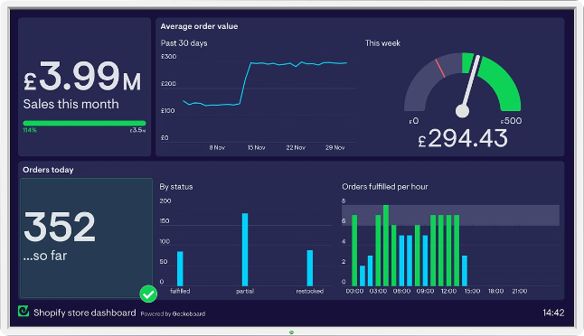
Sales Performance Metrics
Revenue
Total sales income
Orders
Number of completed transactions
Conversion Rate
Orders divided by site visitors
Average Order Value
Revenue divided by number of orders

Slide 7

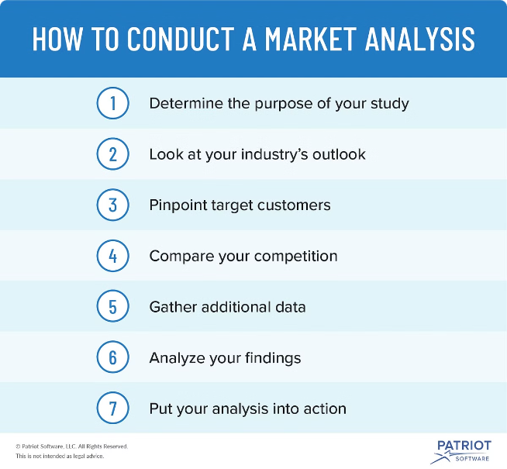



Identifying Market Opportunities
Emerging Categories
Spot high-growth product areas
Underserved Customers
Identify unmet customer needs
Competitive Gaps
Find areas to differentiate your offering

Slide 8





Recommendations and Actionable Insights
Optimize Pricing
Adjust prices based on demand and competition
Enhance Product Listings
Improve content and visuals to drive conversions
Target High-Value Segments
Focus marketing on most profitable customer groups

Slide 9
Thank You

